Slide 1
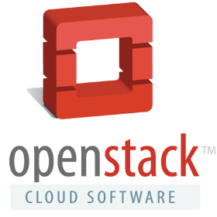
An Overview of OpenStack

Slide 2
What is OpenStack?
Joint project between Rackspace and NASA in 2010
Designed to run on commodity hardware
Open source cloud operating system
Manages a pool of compute, storage and networking resources via CLI or dashboard (web interface GUI)
Sometimes refer as IaaS (Infrastructure as a Service)
Not a product but a sets of tools to build a cloud
Python based
Running Platform – Linux (Ubuntu, RHEL, SUSE)

Slide 3
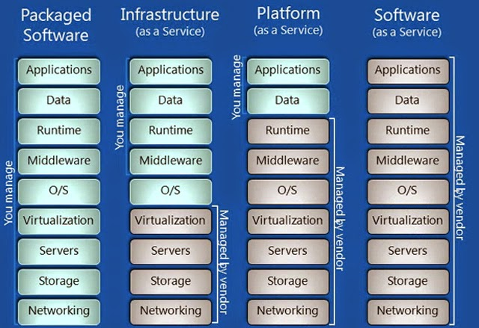

Slide 4
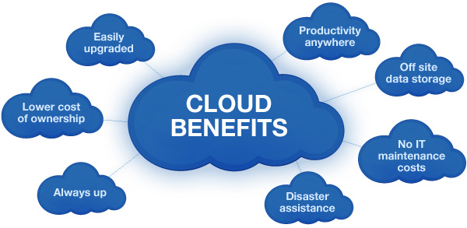
What problem can OpenStack solve?
Essential characteristics of a cloud defined by NIST
On Demand self service
Broad network access
Resource Pooling
Elastic/Agile
Measured service

Slide 5
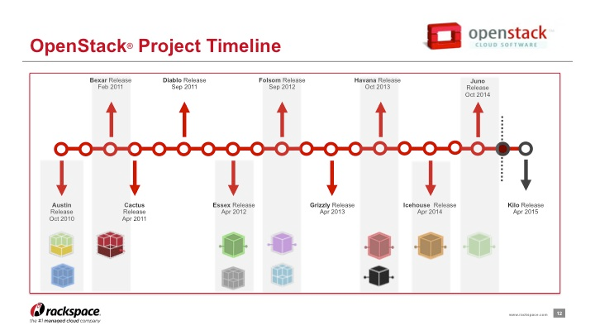
6 Months Release Cycle

Slide 6
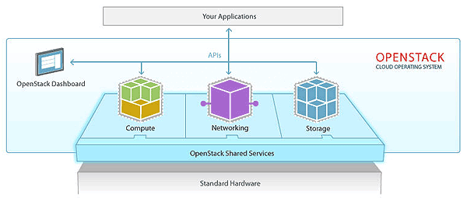
OpenStack Services

Slide 7
OpenStack Projects
Compute:
Nova - provides virtual machines (VMs) upon demand.
Storage:
Swift - provides a scalable storage system that supports object storage.
Cinder - provides persistent block storage to guest VMs.
Networking:
Neutron - provides network connectivity-as-a-service between interface devices managed by OpenStack services.
Shared Services:
Keystone - provides authentication and authorization for all the OpenStack services.
Glance - provides a catalog and repository for virtual disk images.
Horizon - provides a modular web-based user interface (UI) for OpenStack services.
Ceilometer - provides a single point of contact for billing systems.
Heat - provides orchestration services for multiple composite cloud applications.
Trove - provides database-as-a-service provisioning for relational and non-relational database engines.

Slide 8
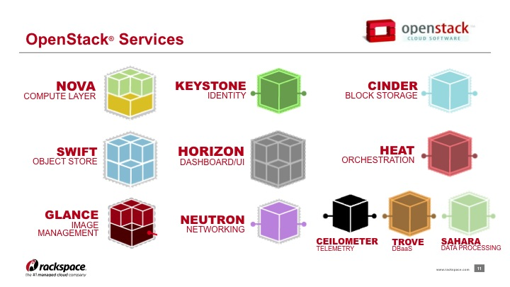

Slide 9
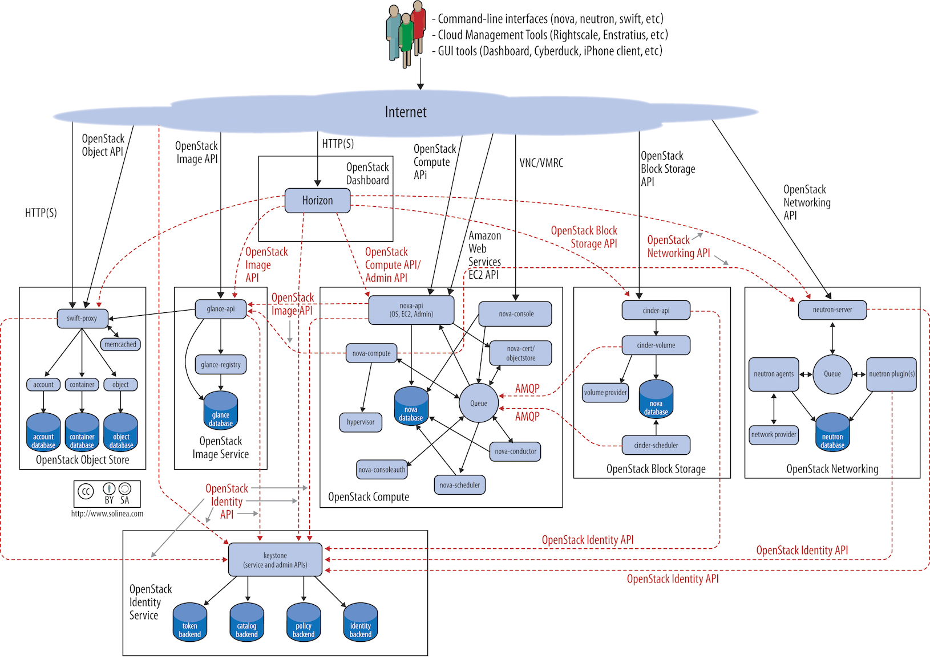

Slide 10
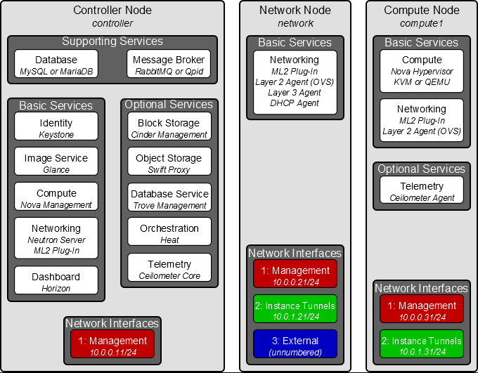

Slide 11
Why do I need OpenStack when I already have vSphere?
OpenStack
Cloud platform
Resource allocation - dynamic
Instance - KVM, Xen or Docker (user supply)
Ephemeral storage
Object storage
Plugin for 3rd party network provider
User can manage also
Open source / free
vSphere
Virtualization platform
Resource allocation – static
ESXi
DRS
HA
FT
Traditional storage architecture
vSphere client for admin only

Slide 12
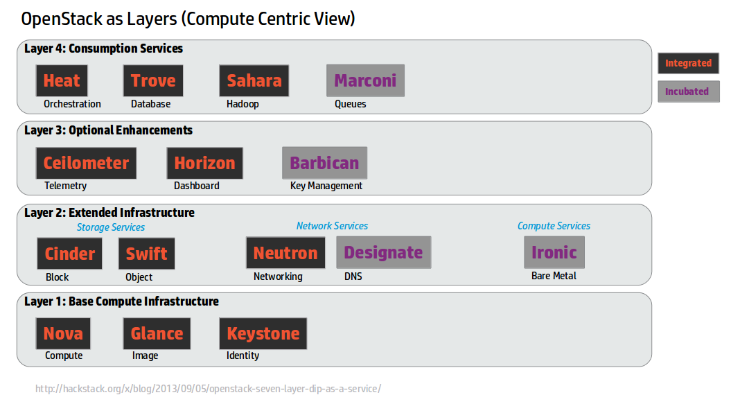
OpenStack Projects (layered view)

Slide 13
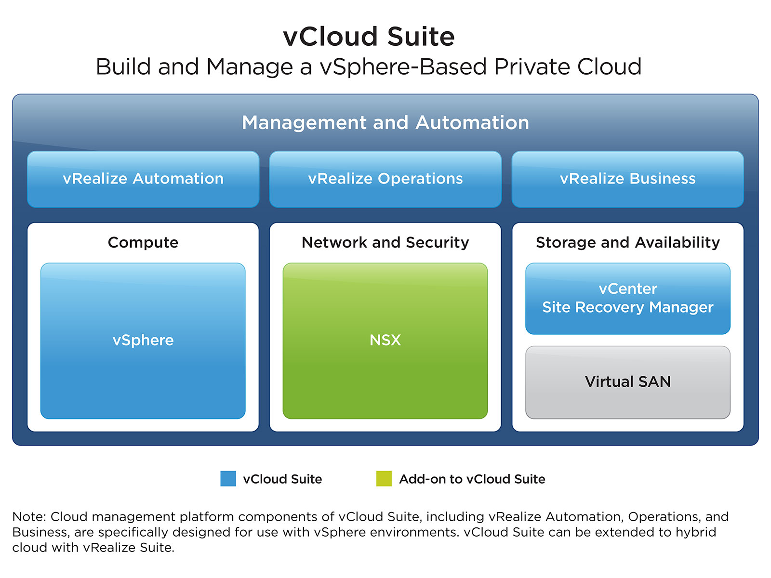

Slide 14
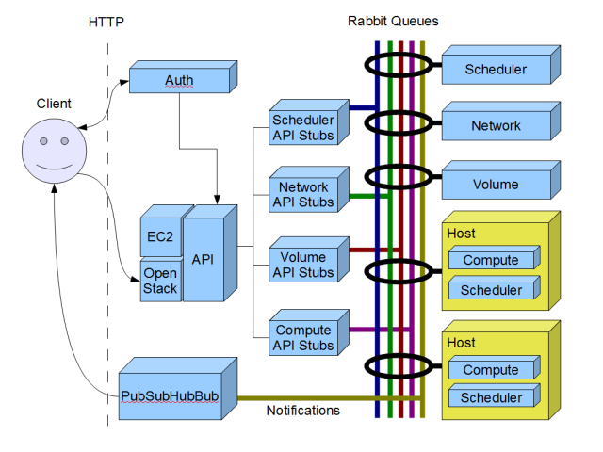
Communication within and between projects
RESTful (Representational State Transfer) API
Message Q systems – RabbitMQ or AMQP

Slide 15
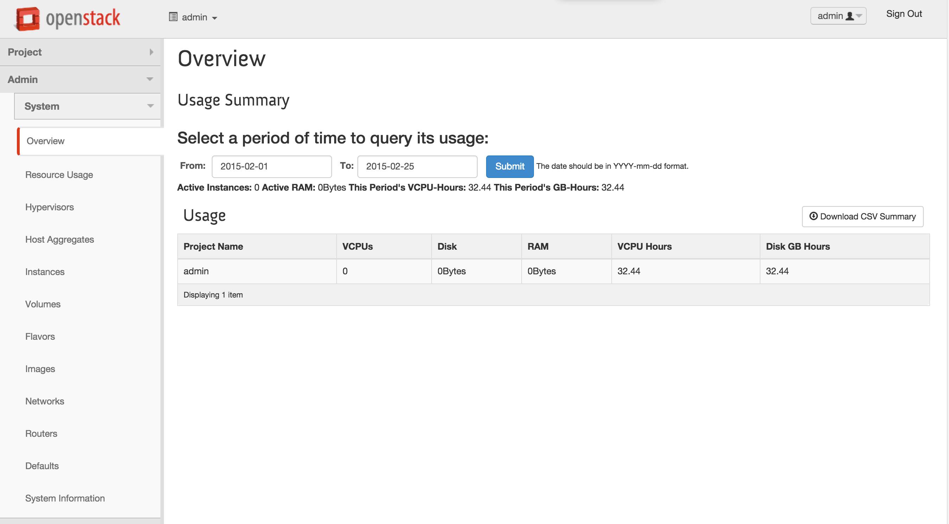

Slide 16
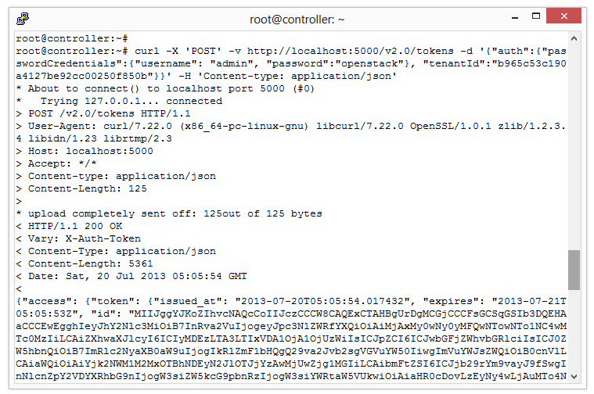
CURL / REST API / JSON

Slide 17
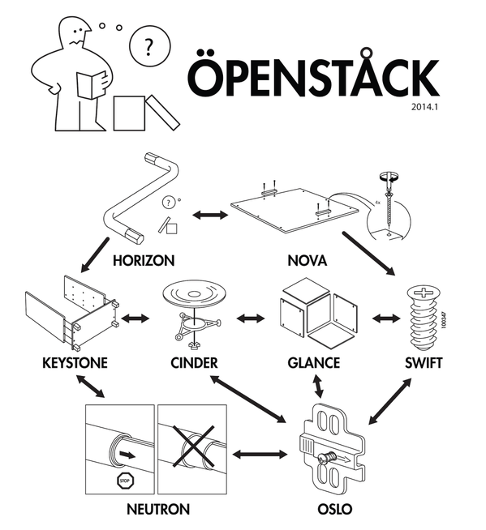

Slide 18
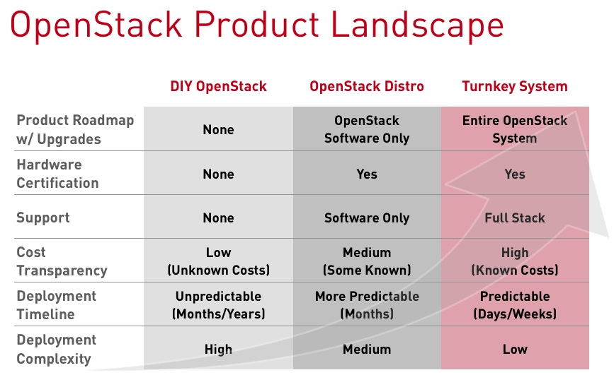
OpenStack Deployment Options
In-house private cloud from GitHub (DIY approach)
In-house private cloud from distributions (software and/or hardware)
Hosted private cloud (on premises)
Public cloud
Consultant and Integrators

Slide 19
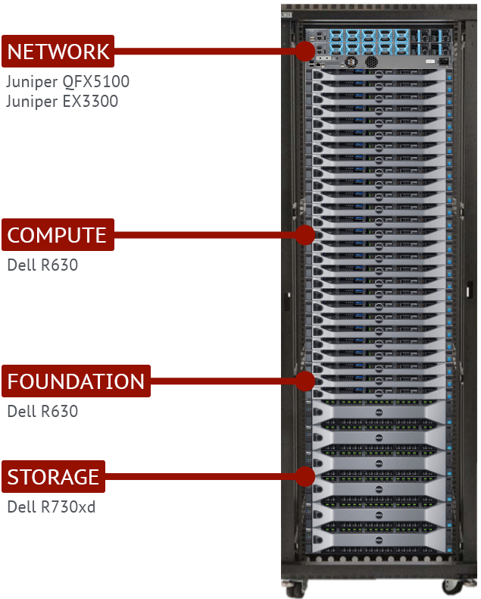
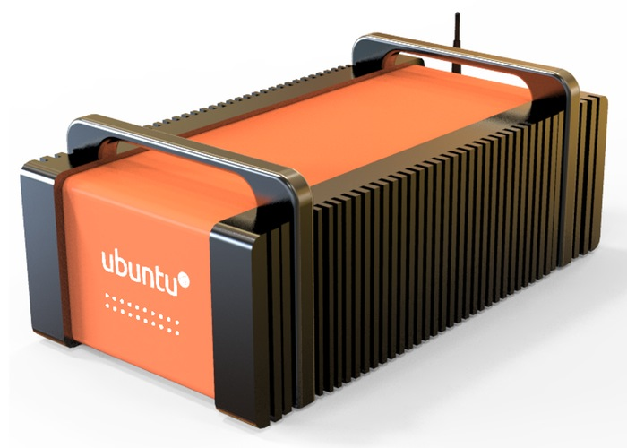
Pre-installed OpenStack systems

Slide 20
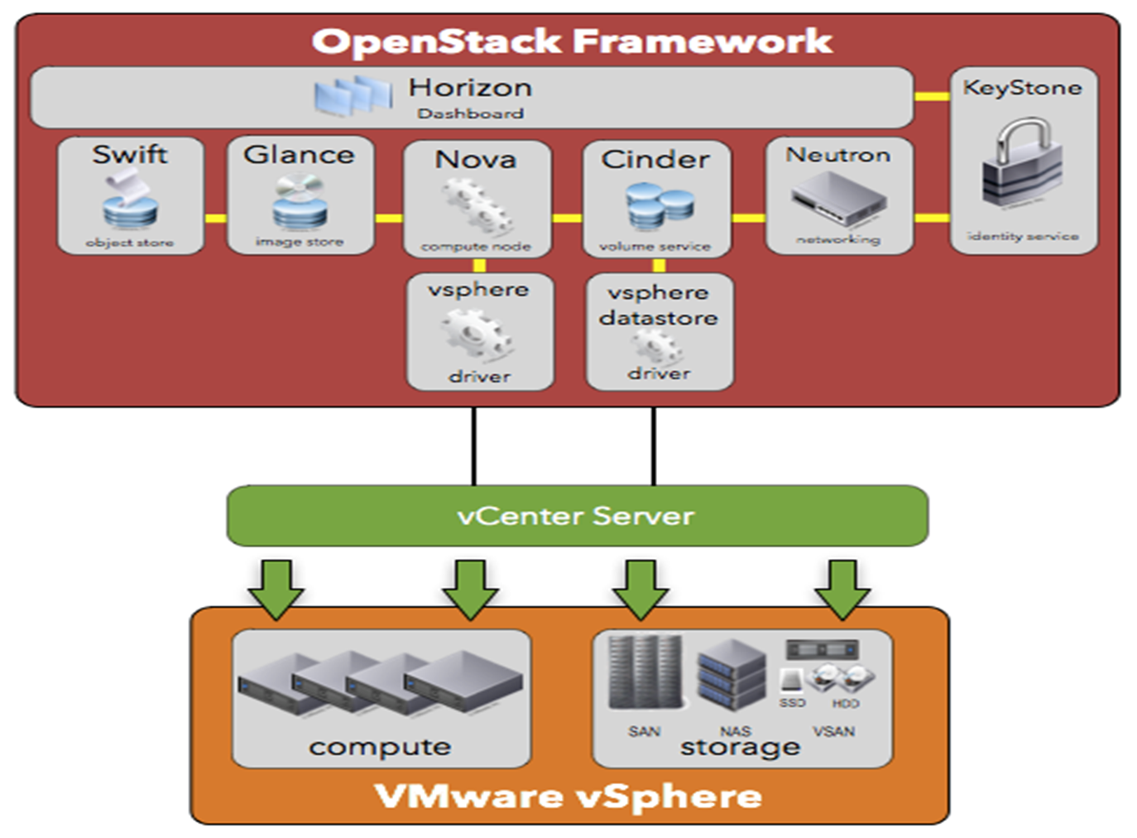
Running OpenStack over vSphere

Slide 21
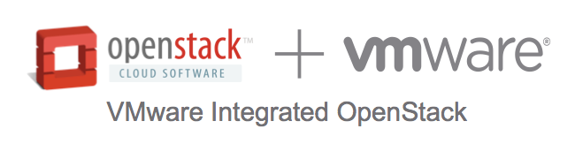
VMware Integrated OpenStack – VIO
Free
Support available – $200 per CPU annual free
Minimum support order size = 50 CPUs
Compatible with
vRealize Operations (Enterprise edition)
All editions of vCloud Suite
Deployment requirement
vSphere Enterprise Plus – DRS and VDS
vSphere Enterprise with VSAN and NSX

Slide 22
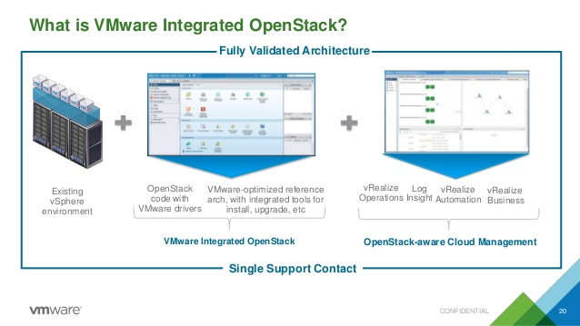

Slide 23
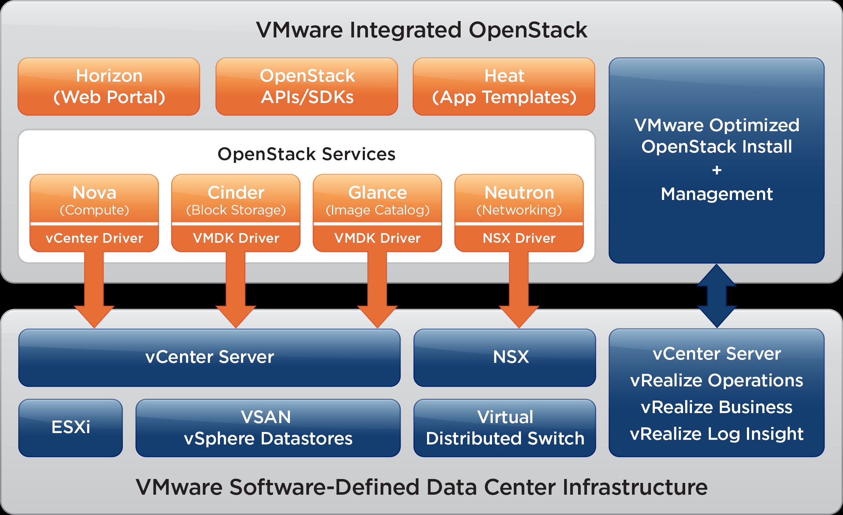
VMware Integrated OpenStack

Slide 24
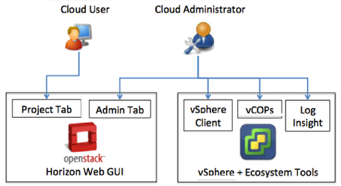

Slide 25
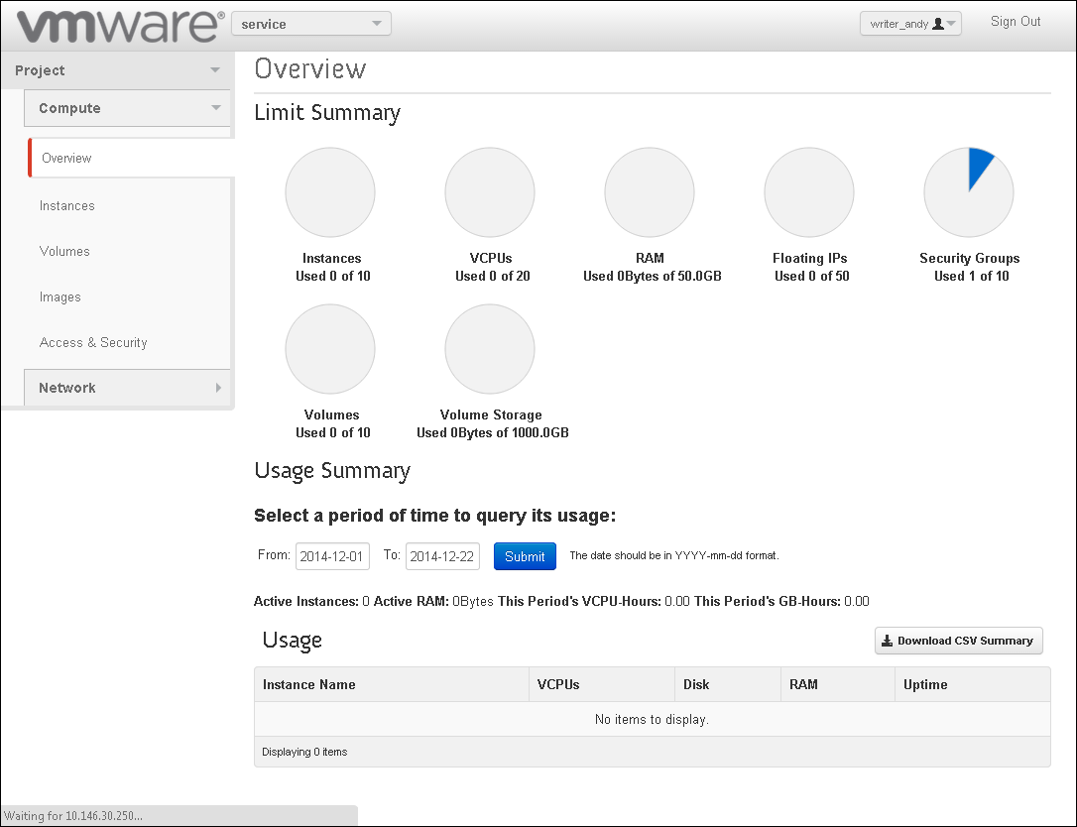

Slide 26
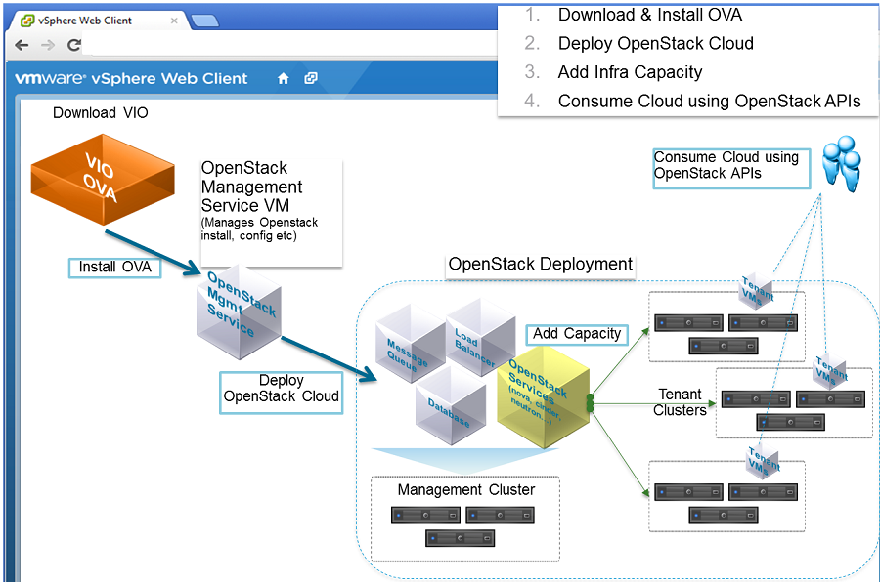

Slide 27
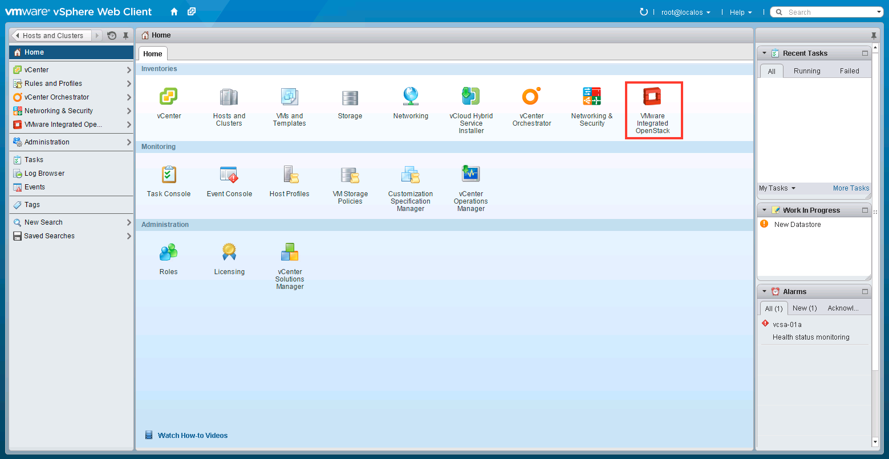

Slide 28
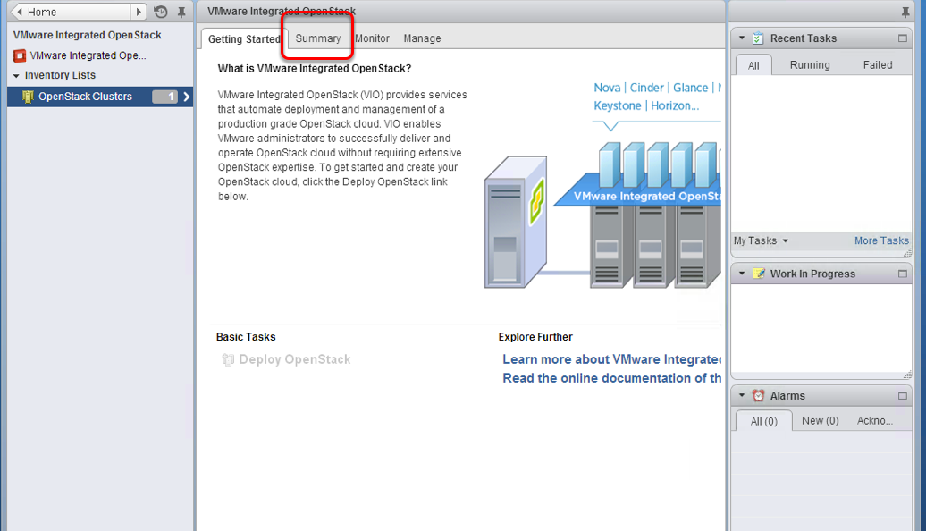

Slide 29
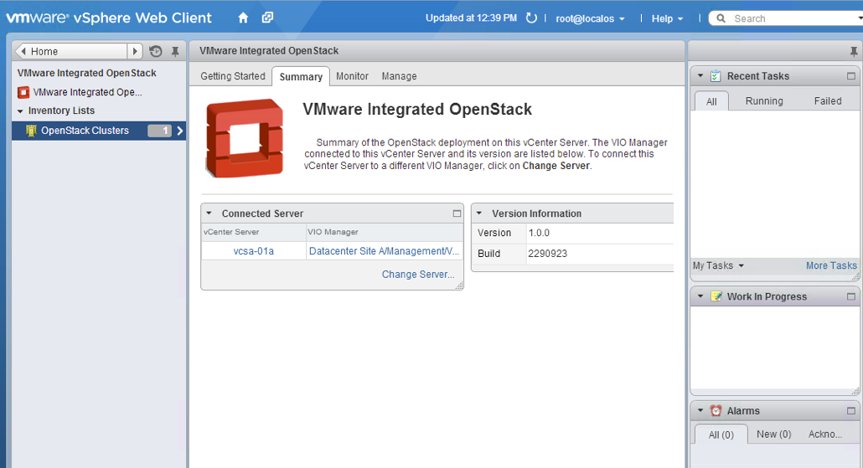

Slide 30
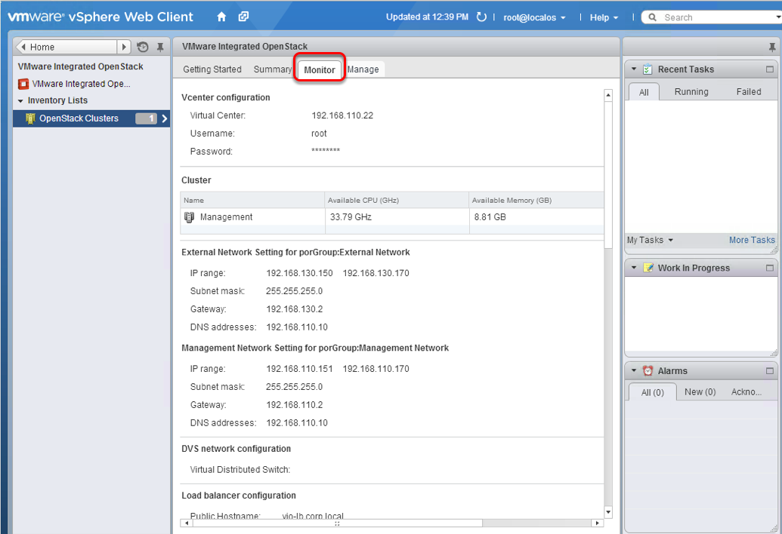

Slide 31
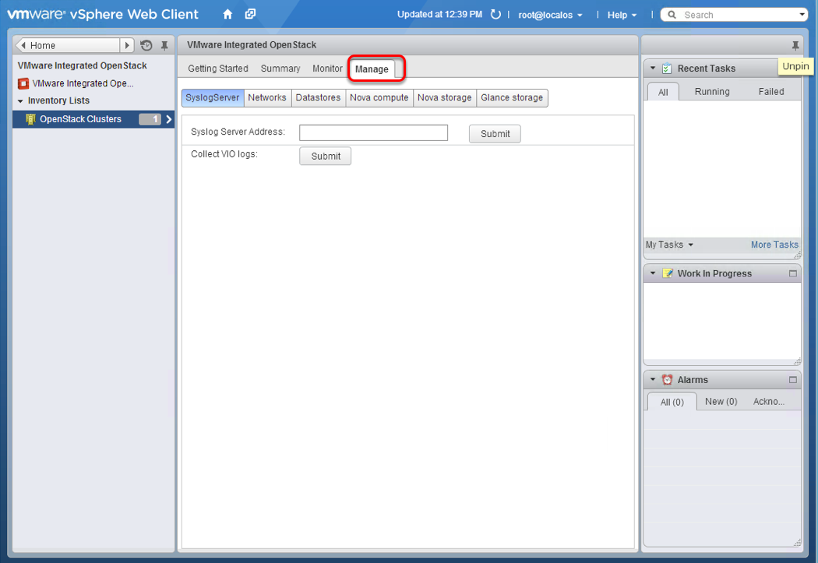

Slide 32
OpenStack Ecosystem
BigData
Red Hat
Cisco
Rackspace
Storage
Solidfire
SwiftStack
Ceph
Networking
Akanda
PLUMgrid
Midikura
PaaS
Red Hat OpenShift
IBM SoftLayer
HP Helion

Slide 33
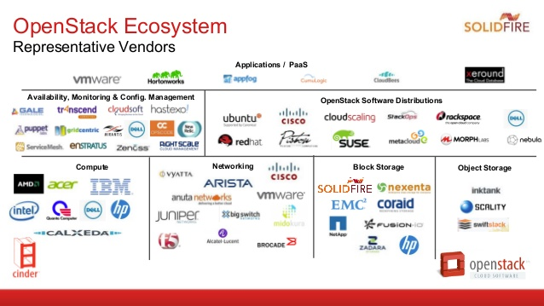

Slide 34
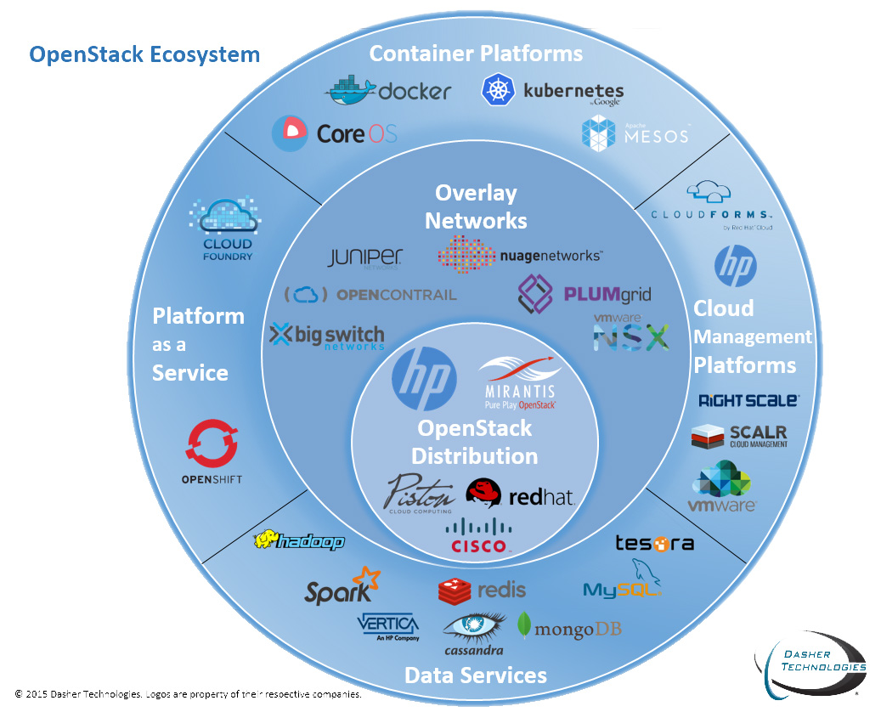

Slide 35
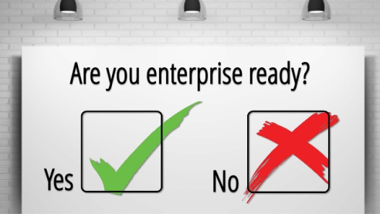
Is OpenStack “enterprise” ready?
High Availability (HA)
VMware vSphere
Red Hat Enterprise Linux 7 - Pacemaker
Ubuntu – High Availability Cluster Solutions
SUSE Linux Enterprise High Availability Extension 12
Security
Active Directory as Keystone backend
RESTful API – security token
Dedicated Security team
SecurityImpact
2 Releases per year may be too much to upgrade
Do we have enough in-house expertise?
Google becoming a sponsor to OpenStack Foundation
OpenStack Innovation Center (Rackspace & Intel)

Slide 36

Companies that use OpenStack
CERN – Storage and data processing
Walmart – eCommerce
BMW – Global Data Center

Slide 37

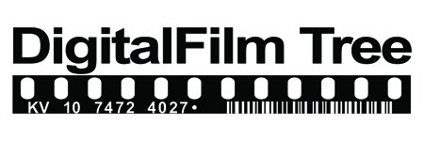
DigitalFilm Tree

Slide 38
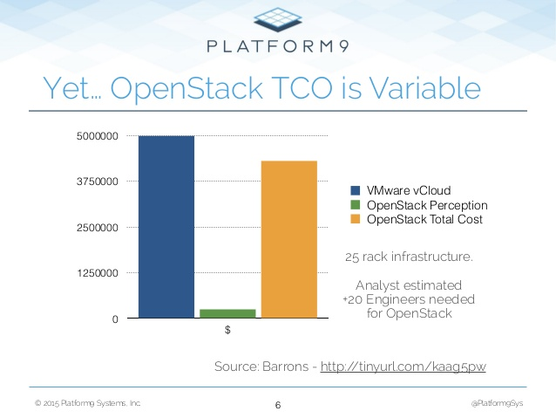
Total Cost of Ownership (TCO)
Able to run on commodity hardware
Open source – it is free
Hidden cost for support and operations
May be difficult to measure

